Slide 1
Sugar Daddy Vitamin
Kylie Owens
Taylor Whitfield
Anna Eades
Julia Elder
Celeste Wearing

Slide 3
What do diabetics need?
Regulated carbohydrate intake
Fiber
Protein
Vitamins
Vanadium

Slide 4
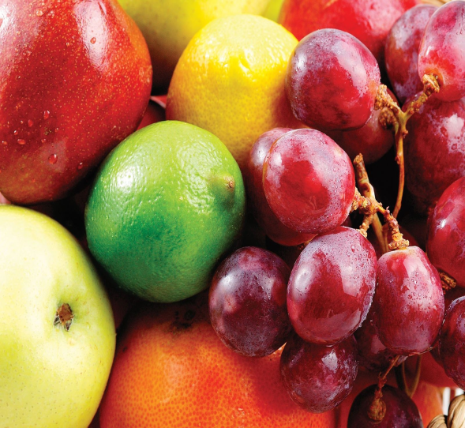
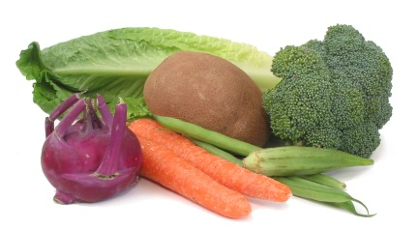
What Specific Vitamins?
Vitamin E
Vitamin B
Vitamin C

Slide 5
Inventing the Vitamin
Regulate glucose
All natural
Simple to make
Cheap/cost efficient

Slide 6
Vitamin Ingredients
Fiber
Fish Oil
Canola Oil
Vegetable Oil
Orange Juice Extract
Fruit Juices

Slide 7
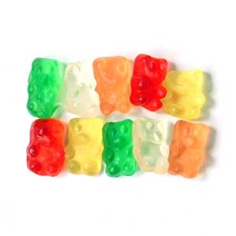
Marketing of Vitamin
Name: Sugar Daddy Vitamins
Gummy Vitamins
Different Shapes
Colorful

Slide 8
Resource Page
PubMed Health (google type 1)

