Slide 1
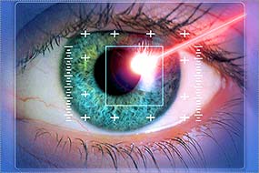
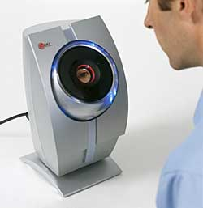
EyeSeeYou
By: Julia Elder, Anna Eades, Marques Angel

Slide 2
Company Goals
To provide quick access
Easy security method
Safe environment for flying clients
Reliable machinery
Cost efficient for the companies that are purchasing the product

Slide 3
Biometrics
What can they do for the airport?
Security
Will make sure flying clients are who they say they are
Can be checked when purchasing ticket, at costumes, and boarding plane.
Can be used as tickets
Besides showing identification and ticket
Passport is digital within eye scanners

Slide 4
Retinal Scan
Measures the pattern of blood vessels in the back of the eye, and is obtained by shining an infrared light through the pupil
Could visually impair flying clients for a short period of time
Time-consuming
Do NOT want to use this scan!

Slide 5
Iris Recognition
Can be performed using a video camera, and examines the unique patterns of ridges on the colored portion of your eye
Does not require physical contact with scanner
A decrease in germs
Less contamination than the use of fingerprint scanners
Isn’t affected by contacts
More efficient for clients that have contacts

Slide 6
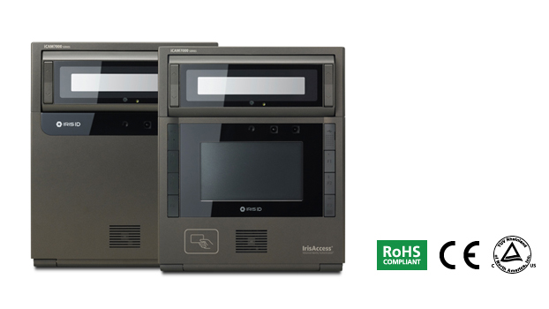
Machine
Downloads Information into FBI Database
Three Thousand Dollars Each
No Contact
Can be used at each checkpoint
Ticket Station
Costumes
Boarding Location

Slide 7
Where Has It Been Used Before?
Jorge the Illegal Immigrant
Crossed the boarder to America
Wanted to fly from Los Angeles to New York
Was identified as not a citizen when eyes were scanned at the airport
He was deported

Slide 8
Watch Out For Criminals
How could they possibly “beat the system”?
High resolution photos
Contacts
Eye Replacement

Slide 9
How Does Information Remain Private?
System connected to FBI database
Restricts unauthorized eyes
Can identify criminals, citizens, and unknown

Slide 10
Resources
Color ID editors, et al. (2013) IRIS ID: iCAM7000. Resources: http://www.colorid.com/detail.com.aspx?ID=702

