Slide 1
Huntington’s Disease
Julia Elder

Slide 2
Patient profile
Susan is an adult of about thirty five years of age
Currently being treated for depression and mood swings
Experiencing memory loss
Mother encountered the same problems
Thought to have Huntington’s Disease.

Slide 3
Huntington’s disease
HD is a neurodegenerative genetic disease
-Is an autosomal dominant disorder
Can occur at any age, although patients usually acquire it between the ages of 35 and 44
Patients experience spasms and loss of muscle control
Other symptoms include psychosis and mood swings
Current theories suggest that Huntington’s, the protein formed as a result of the abnormal HD gene (IT15), somehow prevents the brain cells from protecting themselves against the toxic chemicals
Neurological disorder of the central nervous system that causes progressive degeneration

Slide 4
Symptoms
Emotional
Depression
Mood Swings
Physical
Balance
Spasms
Clumsy
Dizziness
Mental
Forgetful

Slide 5
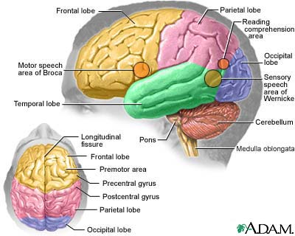
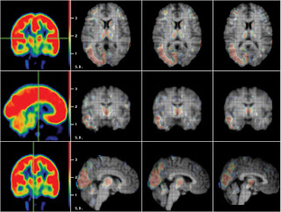
Relation of symptoms to brain
The frontal lobe controls emotions such as depression and mood swings
Balance is controlled by the cerebellum
The temporal lobe is responsible for memory
http://chromosome4.blogspot.com/2011/05/definition-of-huntingtons-disease.html
http://www.encognitive.com/files/images/human-brain-frontal-lobe.jpg

Slide 6
Treatments
Although no treatment currently exists for Huntington’s Disease, treatment options include tetrabenazine, neuroleptics and benzodiazepine which have been approved for the treatment of HD with varying results.
Tetrabenazine – Designed for the treatment of hyperkinetic movement disorder (HMD) and chorea, tetrabenazine was the first drug in America to be approved for use on HD.
Neuroleptics Benzodiazepine – Primarily used to manage psychosis as in HD, benzodiazepine can also be used for schizophrenia and bipolar disorder.

Slide 7
Psychiatrist
Psychiatrists can help the patient adapt to their newly contracted disease, as well as assist the patient in coping with the new lifestyle that comes with the onset of Huntington’s Disease.
Psychiatrists also help with the depression many HD patients suffer with counseling and medicine.
The median annual wage for a psychiatrist is $130,000

Slide 8
Physical therapist
Physical therapists can provide therapy sessions to inform the patient on how to improve posture, balance, and muscle coordination.
Those with HD have frequent muscle spasms and loss of balance, which can be improved with the help of a physical therapist.
The average yearly salary for a physical therapist is around $75,000

Slide 9
Reference
http://www.hdsa.org/living-with-huntingtons/family-care/index.html
http://www.bls.gov/ooh/healthcare/physical-therapists.htm
http://vikipedio.org/physiatrist-salary-and-job-description/
http://www.mayoclinic.com/health/huntingtons-disease/DS00401/DSECTION=symptoms
http://www.medicinenet.com/huntington_disease/article.htm
http://chromosome4.blogspot.com/2011/05/definition-of-huntingtons-disease.html

